Slide 1

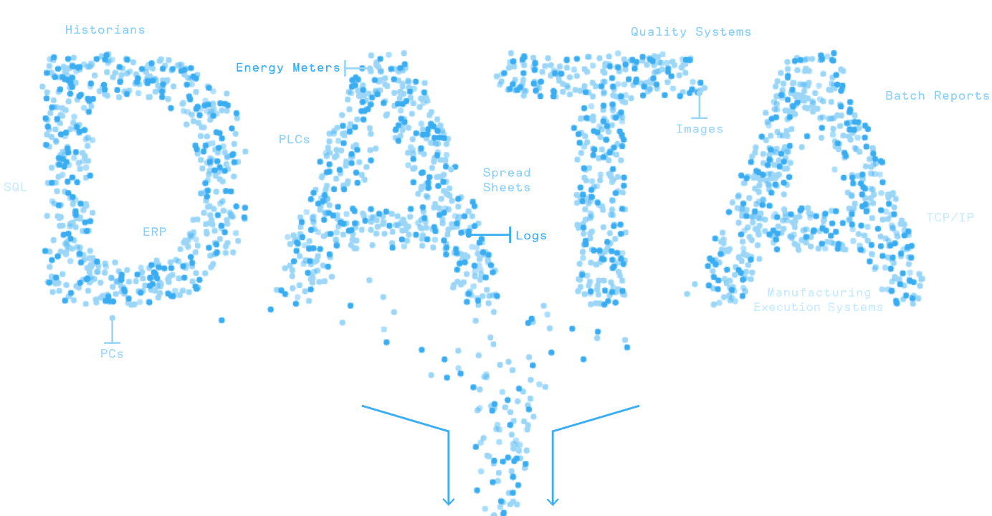


MATLAB Fundamental Laboratory Handbook (MATLAB)
Chapter 10 Object-Oriented Programming
Dr Leo Chen
leo.chen@ieee.org
1

Slide 2
10. 1 Lab
Objective: Create Classes and Objects.
Content: Create a class Student that contains the student's name and school. Create an object that displays student information.
Create Class:
Create Object:
classdef Student
properties
name = "Jack";
school = "Suzhou No.1 Primary School";
end
methods
function obj = Student(name, school)
obj.name = name;
obj.school = school;
end
function info(obj)
disp("Name: " + obj.name);
disp("School: " + obj.school);
end
end
end
student1 = Student("Mary", "Shanghai Experimental Primary School");
student1.info;
Results：
Name: Mary
School: Shanghai Experimental Primary School

Slide 3
10. 2 Lab
Objective: Use inheritance to create Classes.
Content： Create a subclass of Student, CollegeStudent, using inheritance, adding the field major.
Create Class:
Create Object:
classdef CollegeStudent<Student
properties
major
end
methods
function obj = CollegeStudent(name, school, major)
obj = obj@Student(name, school)
obj.major = major;
end
function info(obj)
info@Student(obj);
disp("Major: " + obj.major);
end
end
end
student2 = CollegeStudent("Mike", "Peking University", 'Math');
student2.info;
Results：
Name: Mike
School: Peking University
Major: Math

Slide 4
10. 3 Lab
Objective: Set access control for MATLAB class.
Content： Set access to the property school of the class Student to protected.
Create Class:
Create Object:
classdef Student
properties
name = "Jack";
end
properties (Access = protected)
school = "Suzhou No.1 Primary School";
end
… % the same with “10. 1 Lab” 。
student1 = Student("Mary", "Shanghai Experimental Primary School");
student1.info;
student1.name
student1.school
Results：
Name: Mary
School: Shanghai Experimental Primary School
ans = "Mary"
类 'Student' 没有公共属性 'school'。

Slide 5
10. 4 Lab
Objective: Write the overloaded function.
Content： Add getScoreLevel to class Student to view the grade (Excellent, Good, Pass, Failed) according to the score, override this function in class CollegeStudent, the grade becomes A, B, C, D, E.
getScoreLevel in Student ：
getScoreLevel in CollegeStudent ：
function level = getScoreLevel(~,score)
if score >= 85
level = "Excellent";
elseif score >= 75
level = "Good";
elseif score >= 60
level = "Pass";
else
level = "Failed";
end
end
function level = getScoreLevel(~,score)
if score >= 90
level = "A";
elseif score >= 80
level = "B";
elseif score >= 70
level = "C";
elseif score >= 60
level = "D";
else
level = "F";
end
end
运行结果：

Slide 6
10. 5 Lab
Objective: Define the event of the class.
Content： Create a class, define the Event of the class, listen to whether the time changes, if changed, display the time.
Create Class:
Create Object:
classdef Clock < handle
properties
time = datetime("now");
end
events
TimeChange
end
methods
function change(obj, t)
if (obj.time ~= t)
obj.time = t;
notify(obj, 'TimeChange')
end
end
function showTime(obj, src, data)
disp(['时间：' + string(obj.time)])
end
end
end
c = Clock;
h1 = c.addlistener('TimeChange', @c.showTime); % Create a listener for the event.
c.change(datetime("now")); % Notify the listener that an event is occurring
c.change(datetime("2014-5-5")); % Time changed, display time
c.change(datetime("2014-5-5")); % The time is unchanged. The time is not displayed
delete(h1); % Delete listener
c.change(datetime("now")); % The time changes and the time is not displayed
时间：2024-04-06 13:31:57
时间：2014-05-05
Results：

